Slide 1
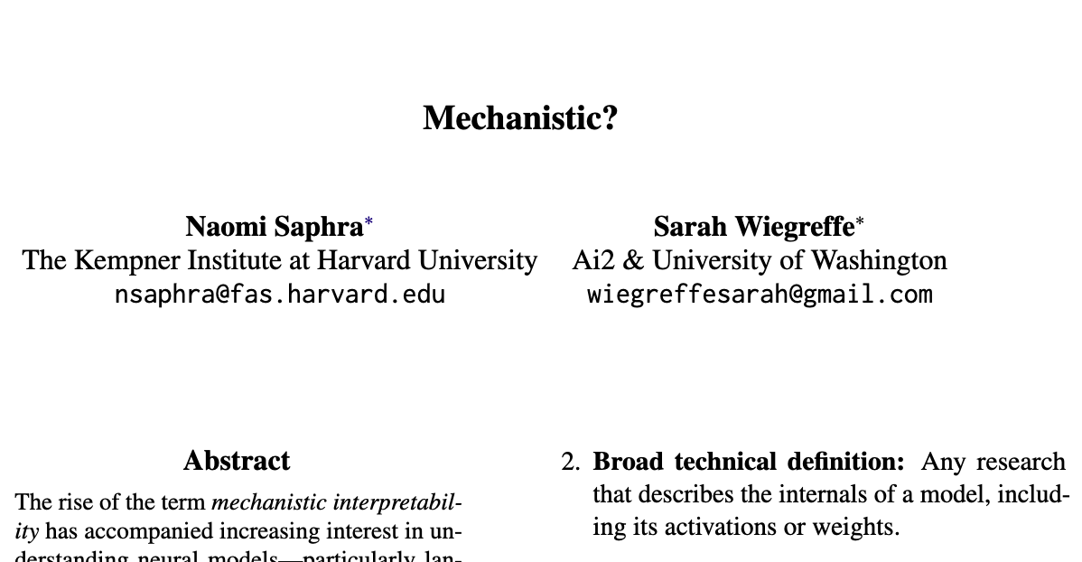

Slide 2
Mechanistic interpretability
Mechanistic interpretability is everywhere, but people don’t agree on what it is
Position paper: ambiguity hides a cultural rift and leads to duplicate research
Before: mechanisms refer to internal algorithmic implementation (Marr’s levels of analysis)

Slide 3
Mechanistic interpretability
Narrow technical definition: understanding neural networks through causal mechanisms
Broad technical definition: any research describing internals of a model
Narrow cultural definition: any research originating from the MI community
Broad cultural definition: any reserch in AI/NLP interpretability

Slide 4
Narrow technical definition
Discover causal mechanisms explaining all or some part of the change from input to output at the level of intermediate model representations
Psychology: humans prefer causal explanations
Causal abstraction: causal models at higher levels of granularity can be faithful simplifications of the true causal model

Slide 5
First usage of the term
Chris Olah (2020): “understand the mechanistic implementations of neurons in terms of their weights”
Elhage et al. (2021): “attempting to reverse engineer the detailed computations performed by Transformers, similar to how a programmer might try to reverse engineer complicated binaries into human-readable source code.”

Slide 6
“How did we get here? A history of two LM interpretability communities”
MI started as a movement in computer vision
ML appeared to be a CV thing
Natural Language Processing Interpretability (NLPI) focused analyses of linguistic structure in neural models

Slide 7
Natural Language Processing Interpretability (NLPI)
Distributional semantics and representational similarity
Remember word2vec?
But: not all interesting properties of word embeddings correlated with downstream model behaviour
Attention maps
Neuron analysis and localisation

Slide 8
Probing
Individual neurons were associated with sentiment, syntax, bias, or specific token sequences
But: models are more than the sum of their parts
Polysemanticity: a single neuron can activate for more concepts
Focus shifted to circuits
Probing to extract linguistic information from the hidden states of neural models

Slide 9
Probing
Problems
Lack of clear baselines
Appear to extract information from random embeddings
Probe is learning target task itself
Incomplete causal explanation
But: MI is (back to) projecting hidden states…
e.g. logit lens

Slide 10
Mechanistic Interpretabillity as a field
”Machine learning = computer vision”
CV interpretability: feature saliency, highlighting pixels

Slide 11
GPT-3+
“LMs posed an existential risk which could be tempered by deeper understanding”
MI brought a distinct culture to LM analysis
Nanda (2022): MI “feels distinct”, differentiated by its “culture”, “research taste”

Slide 12
MI in blogs
Who invented the logit lens?
Until mid-2023, most MI research was shared on forums or blogs, Discord, Slack
Findings were rarely published
Many NLPI researchers were unaware of this MI community

Slide 13
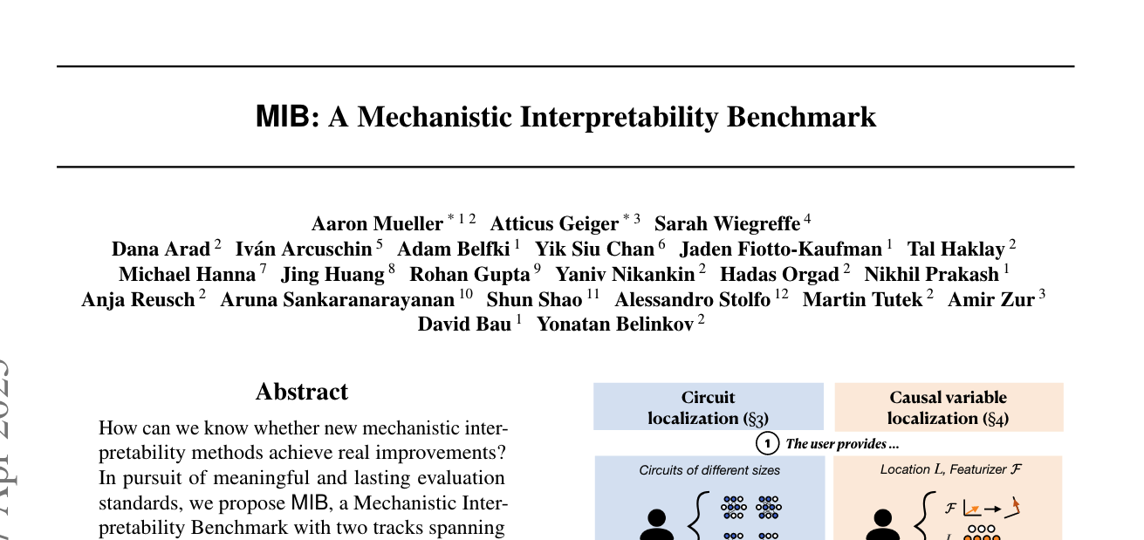

Slide 14
MIB: A Mechanistic Interpretability Benchmark
How can we know whether new mechanistic interpretability methods achieve real improvements?
How can we evaluate and compare methods?
Goal of MI: the ability to precisely locate, and causally validate, task mechanisms or specific concepts in a neural network

Slide 15
Two tracks
Circuit localisation: identify (minimal) set of model components and connections that drive task behaviour
Causal variable localisation: map hidden-state directions/features that implement a specific causal variable (e.g. concepts)

Slide 16
Four tasks
Indirect Object Identification (IOI)
Arithmetic
Multiple-Choice Question Answering (MCQA)
AI2 Reasoning Challenge (ARC)
Counterfactuals are the backbone of this benchmark

Slide 17
Indirect Object Identification (IOI)
“When Mary and John went to the store, John gave an apple to Mary”
Counterfactual inputs
Random names: “When Paul and Lily …”
ABC: “… Bob gave an apple to …”
Changing the orders
subject
indirect object

Slide 18
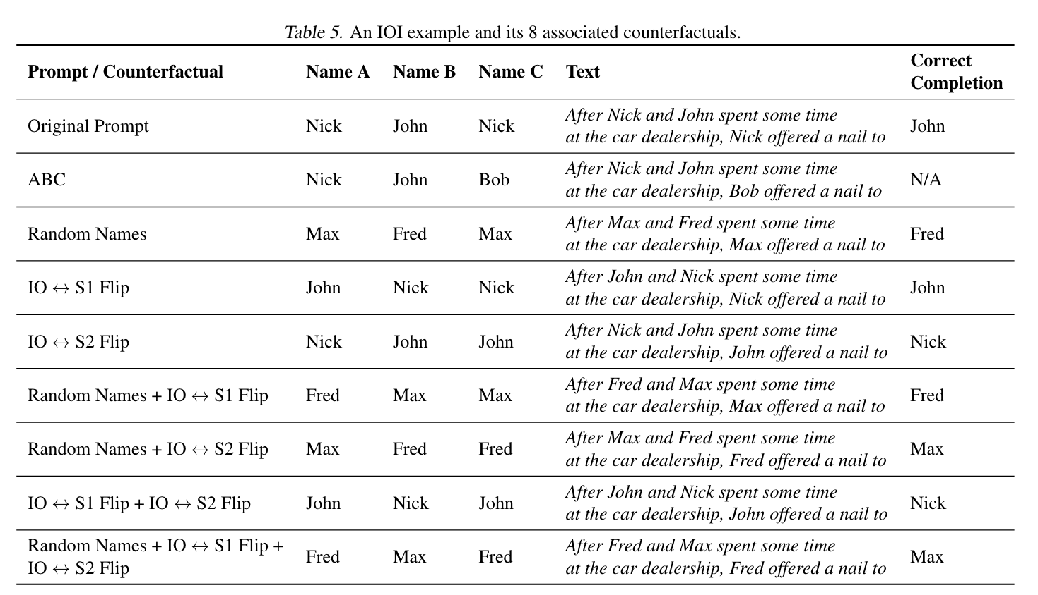

Slide 19
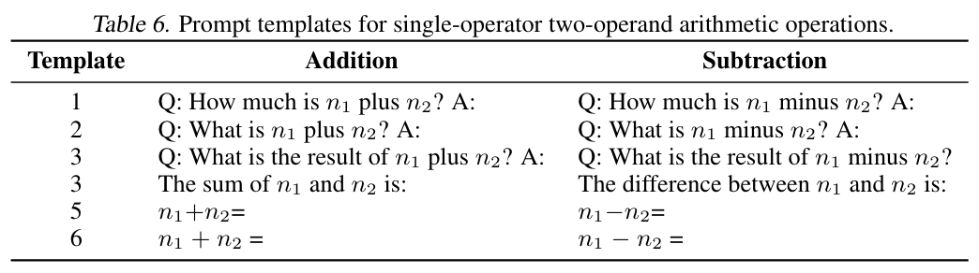
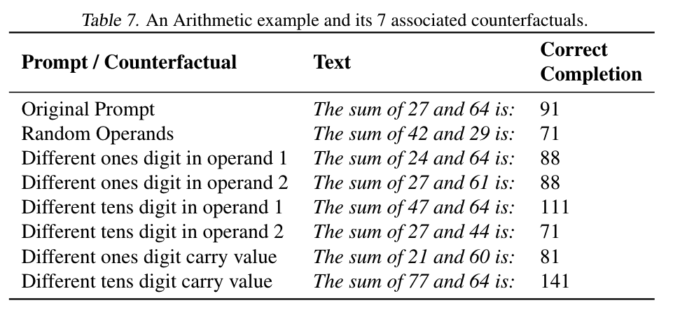
Arithmetic

Slide 20
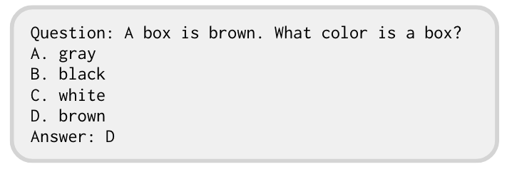
Multiple-Choice Question Answering (MCQA)

Slide 21
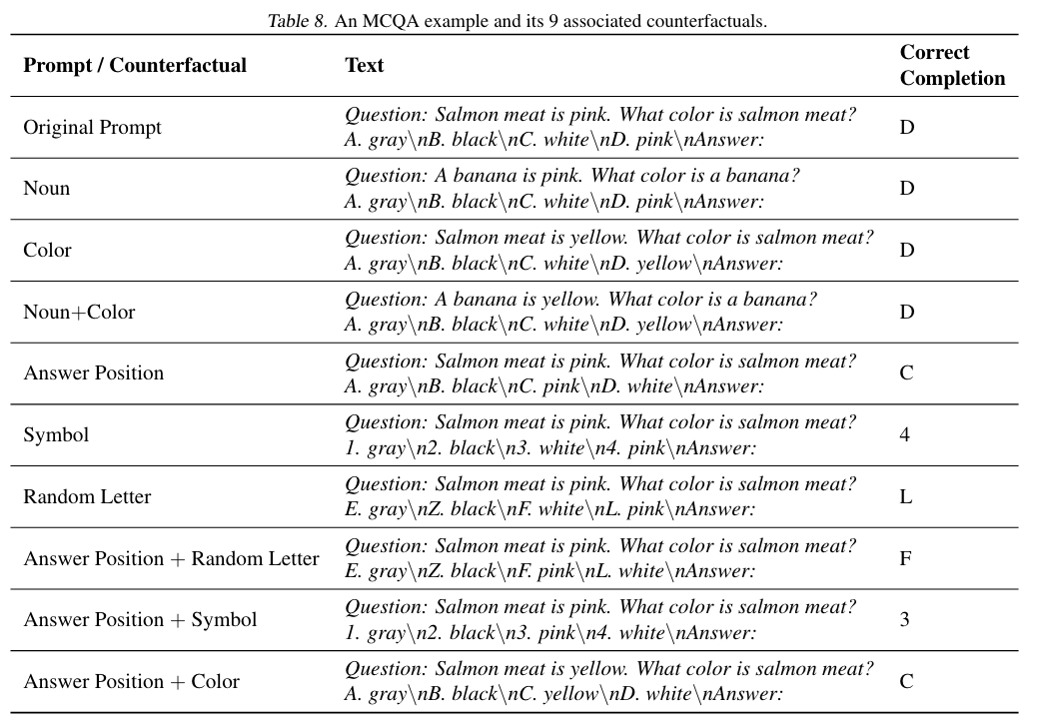

Slide 22
Ai2 Reasoning Challenge (ARC)
Question: How does a tiget get stripes?
from its environment
from its food
from its offspring
from its parents
Answer: D

Slide 23
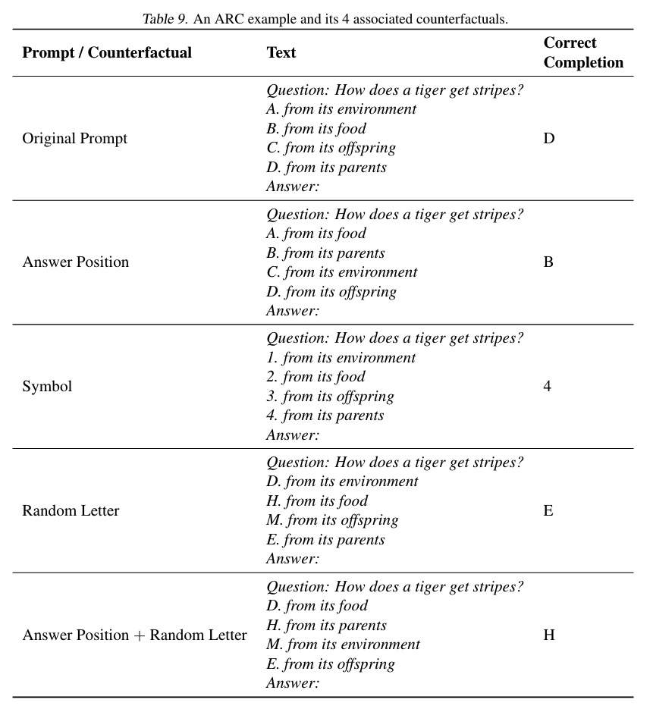

Slide 24
Track 1: Circuit localisation
A circuit 𝒞 is a set of nodes and edges in the computation graph of a full neural network 𝒩
Nodes are typically submodules or attention heads
Involves scoring the components according to their importance: 𝒞 only includes those that exceed a threshold λ

Slide 25
Circuit localisation: metrics
Faithfulness: the extent to which a subgraph 𝒞 explains the full model 𝒩’s behaviour
Can measure whether 𝒞 contributes to a higher task performance
Or: capture any component with any impact
integrated circuit performance rato (CPR)
integrated circuit-model distance (CMD)

Slide 26
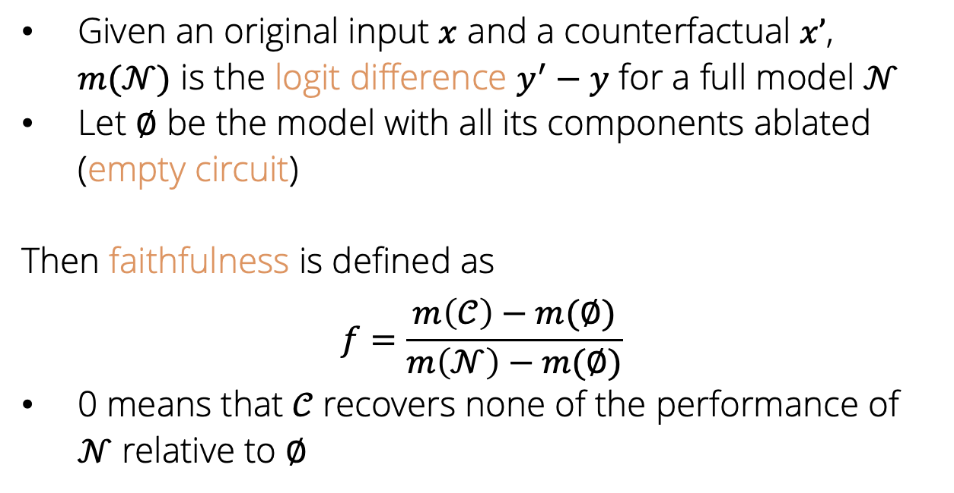
Circuit localisation: metrics
Given an original input $x$ and a counterfactual $x’$, $m(\text{𝒩})$ is the logit difference $y^{′}−y$ for a full model 𝒩
Let ∅ be the model with all its components ablated (empty circuit)
Then faithfulness is defined as
$$f=\frac{m\left(\text{𝒞}\right)−m(\text{∅})}{m\left(\text{𝒩}\right)−m(\text{∅})}$$
0 means that 𝒞 recovers none of the performance of $\text{𝒩}$ relative to ∅

Slide 27
Circuit localisation: metrics
Faithfulness: the extent to which a subgraph 𝒞 explains the full model 𝒩’s behaviour
Can measure whether 𝒞 contributes to a higher task performance
Or: capture any component with any impact
integrated circuit performance rato (CPR)
integrated circuit-model distance (CMD)

Slide 28
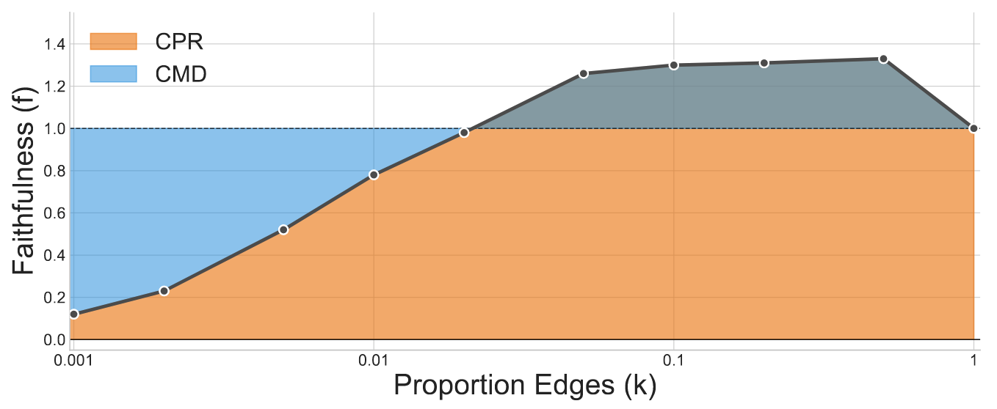
Circuit localisation: metrics
Integrated circuit performance rato (CPR): measure whether 𝒞 contributes to a higher task performance
Integrated circuit-model distance (CMD): capture any component with any impact

Slide 29
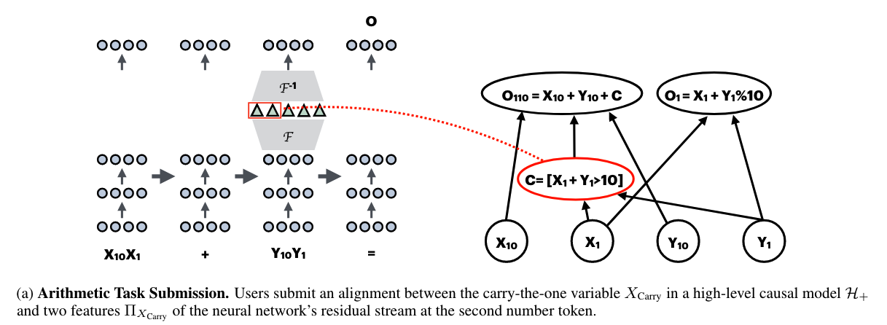
Track 2: Causal variable localisation track
Assumption: models implement intelligent behaviours by representing and manipulating concepts
Task: align these high-level conceptual variables with features in a neural model

Slide 30
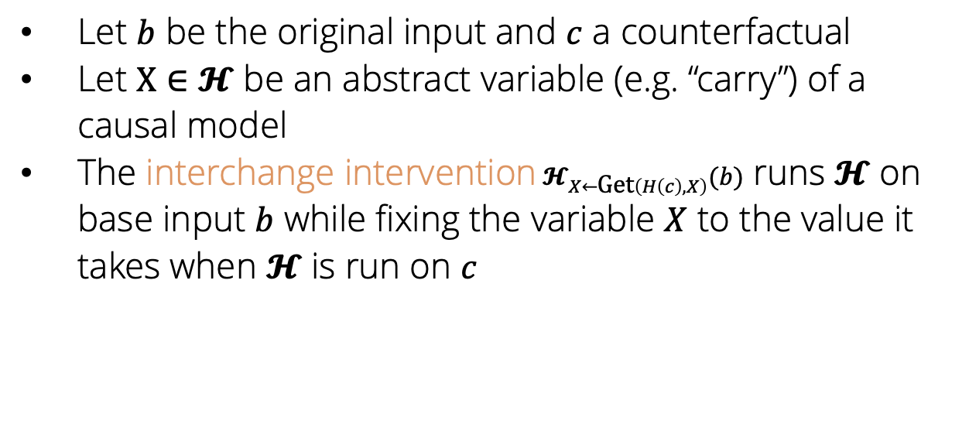
Causal variable localisation: metrics
Let $b$ be the original input and $c$ a counterfactual
Let $X∈𝓗$ be an abstract variable (e.g. “carry”) of a causal model
The interchange intervention$𝓗_{X←\text{Get}\left(H\left(c\right), X\right)}(b)$ runs $𝓗$ on base input $b$ while fixing the variable $X$ to the value it takes when $𝓗$ is run on $c$

Slide 31
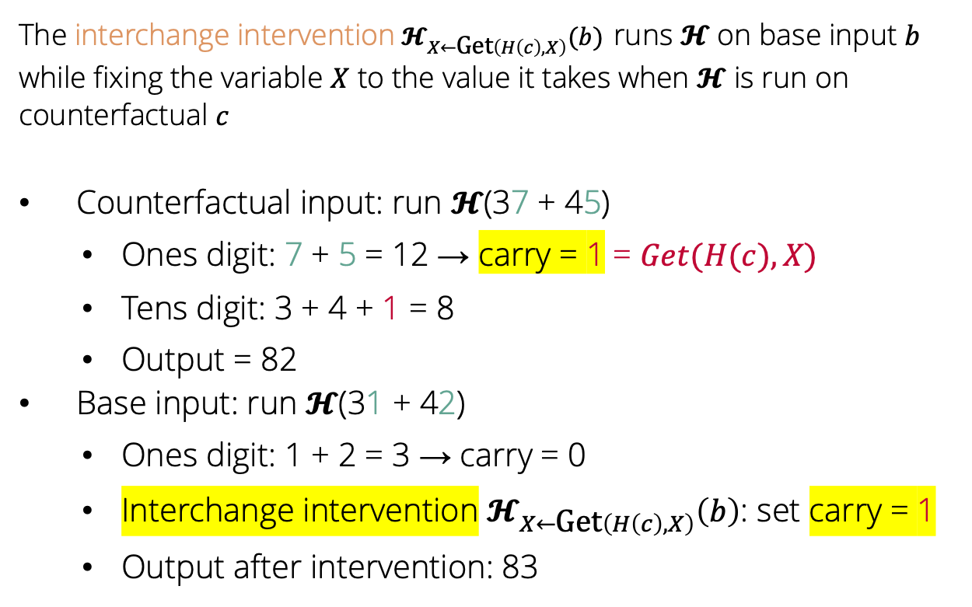
Causal variable localisation: metrics
The interchange intervention$𝓗_{X←\text{Get}\left(H\left(c\right), X\right)}(b)$ runs $𝓗$ on base input $b$ while fixing the variable $X$ to the value it takes when $𝓗$ is run on counterfactual $c$
Counterfactual input: run $𝓗$(37 + 45)
Ones digit: 7 + 5 = 12 → carry = 1 = $Get(H(c), X)$
Tens digit: 3 + 4 + 1 = 8
Output = 82
Base input: run $𝓗$(31 + 42)
Ones digit: 1 + 2 = 3 → carry = 0
Interchange intervention $𝓗_{X←\text{Get}\left(H\left(c\right), X\right)}\left(b\right)$: set carry = 1
Output after intervention: 83

Slide 32
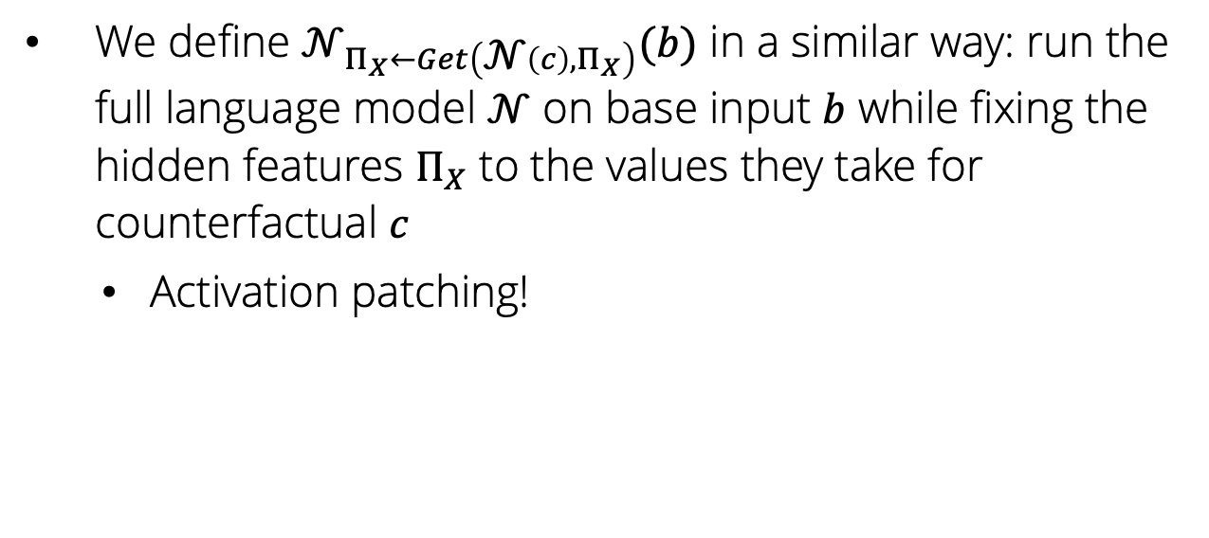
Causal variable localisation: metrics
We define ${\text{𝒩}}_{Π_{X}←Get\left(\text{𝒩}\left(c\right),Π_{X}\right)}(b)$ in a similar way: run the full language model $𝒩$ on base input $b$ while fixing the hidden features $Π_{X}$ to the values they take for counterfactual $c$
Activation patching!

Slide 33
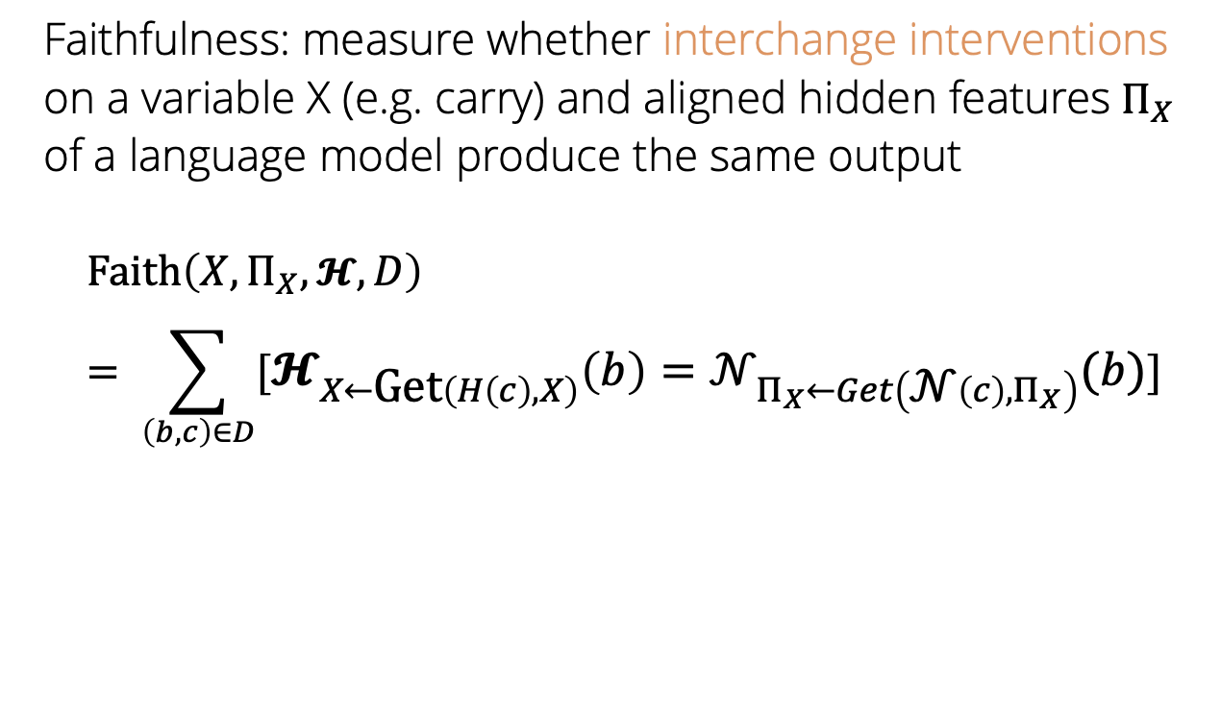
Causal variable localisation: metrics
Faithfulness: measure whether interchange interventions on a variable X (e.g. carry) and aligned hidden features$Π_{X}$ of a language model produce the same output
$$\text{Faith}\left(X,Π_{X},𝓗, D\right)= \sum_{\left(b,c\right)∈D}{[𝓗_{X←\text{Get}\left(H\left(c\right), X\right)}\left(b\right)={\text{𝒩}}_{Π_{X}←Get\left(\text{𝒩}\left(c\right),Π_{X}\right)}(b)]}$$

